Slide 1



Schemes of Branch Prediction

Slide 2
Overview
essential to exploring the full performance of microprocessors
the goal of a branch prediction scheme is to predict accurately the outcome of that conditional branch

Slide 3
Strategies

Slide 4
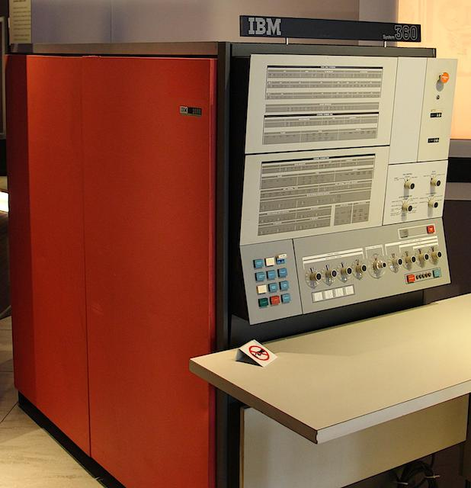
Static Strategies
Strategy 1
predict that branches are always taken/not taken
high program sensitivity can lead to widely different prediction accuracies, therefore, it must be considered
used in some of the IBM System 360/370

Slide 5
Dynamic Strategies
the likelihood of a conditional branch instruction at a particular location being taken is highly dependent on the way the same branch was decided previously

Slide 6
Data Compression & Prediction

Slide 7
TWO-LEVEL BRANCH PREDICTION

Slide 8
Conclusion

